Slide 1

DIGITAL TWIN
Machine learning Model Evaluation
Tejaswi Mahapatra |Silicon Institute of Technology|21bece46

Slide 2


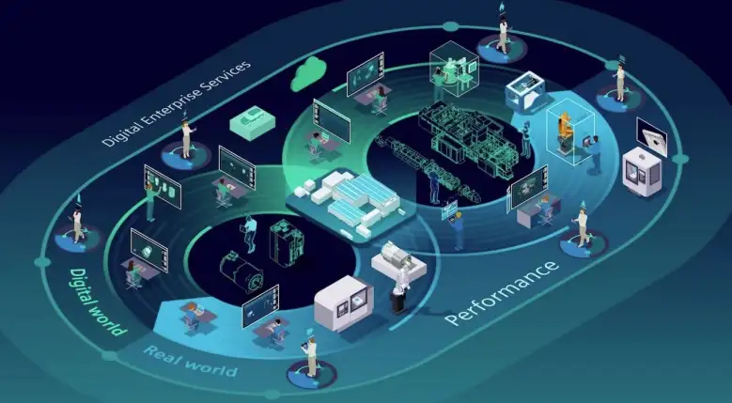
Overview:
Hindalco Industries
Digital Twin Equivalent

Slide 3
Agenda:
To implement Digital Twin, we need an understanding of the Machine Learning Models that are the back-bone of predictive analysis.
The job of making these models has been given to ExactSpace,
Major Points of Discussion:
The loopholes in the creation of the models
Reliability issue of the models
Ways to bridge the gaps

Slide 4
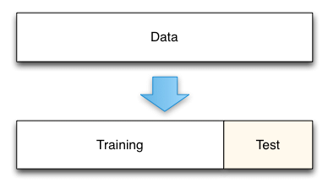
Background of Machine Learning:
Applications : Natural Language Processing(chatbot),sentiment analysis ,etc
What do the machine learning models do?
ExactSpace has deployed all models on four evaluation metrics:
Train RMSE (Root-Mean Squared Error)
Test RMSE
Train R2(Coefficient of Determination)
Test R2
Different Machine Learning Algorithms, such as:
Supervised learning (e.g., regression, classification)
Unsupervised learning (e.g., clustering, dimensionality reduction)
Model Training :
Data collection(Historian)
Data-Preprocessing - Feature Selection & Engineering
Splitting data into training and testing sets.
Choosing an appropriate evaluation metric.
Hyperparameter tuning or optimization(GridSearchCV) techniques.
The training set is used for training the model, and the testing set is used to test your model. This allows you to train your models on the training set, and then test their accuracy on the unseen testing set.

Slide 5
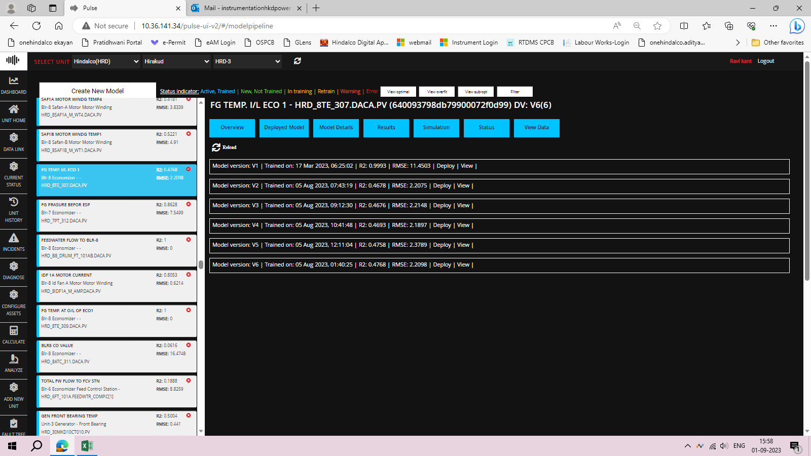
Evaluation Metrics:
There are several different evaluation metrics for classification(f1 score , precision, recall, etc ), regression, etc
In regression models we have metrics like,
Mean Squared Error
Root Mean Squared Error
Mean Absolute Error
R-squared
Adjusted R-squared, etc

Slide 6
Evaluation metrics in Pulse:
Train RMSE: This metric measures the average magnitude of the errors between the predicted values and the actual values in the training dataset. A lower RMSE indicates better fit to the training data. However, focusing solely on train RMSE can lead to overfitting, where the model performs well on the training data but poorly on unseen data. It doesn't give you an idea of how well the model generalizes to new data.
Test RMSE: This is similar to train RMSE, but it measures the errors on the test dataset. Test RMSE gives you an indication of how well the model performs on unseen data. A model with lower test RMSE is generally better, as it indicates that the model is capable of making accurate predictions on new data.
Train R2: R-squared measures the proportion of the variance in the dependent variable that's explained by the independent variables in the model. It ranges from 0 to 1, where 1 indicates a perfect fit. Higher R2 values are better, but like train RMSE, relying solely on train R2 can lead to overfitting.
Test R2: This is the R-squared value calculated on the test dataset. It tells you how well the model's predictions match the actual values in the test dataset. A higher test R2 indicates that the model's predictions generalize well to new data.

Slide 7
Challenges & Pitfalls:
Overfitting(where the model performs well on the training data but poorly on unseen data. It doesn't give you an idea of how well the model generalizes to new data.)
Underfitting(data model is unable to capture the relationship between the input and output variables accurately, generating a high error rate on both the training set and unseen data.), and
Data imbalance(skewness)
Ethical considerations and bias(incorrect assumptions) in machine learning

Slide 8
How to go about evaluating the models:
There are several combinations one can apply when evaluating these metrics but, in this analysis, I’ve considered the following two approaches:
Test RMSE and Test R2: These two metrics are usually the most important when selecting a model for deployment. A model with lower test RMSE and higher test R2 is generally preferred because it indicates that the model not only fits well to the test data but also generalizes better to new, unseen data.
Overfitting Consideration: If a model has much better performance on the training data compared to the test data (i.e., significantly lower train RMSE and higher train R2 compared to test RMSE and test R2), it might lead to overfitting. In such cases, the model might not perform well on new data.
Additionally, it's a good practice to complement these metrics with domain-specific knowledge and visualizations of the model's predictions. This can help us identify any patterns or anomalies that the model might be missing, which could have significant operational implications in a power plant. Ultimately, the choice of metrics should be made in consultation with domain experts and stakeholders from the power plant. The primary goal is to ensure that the deployed model improves operational efficiency, safety, and reliability in line with the specific needs of the power plant.

Slide 9
ANALYSIS OF THE PRESENT MODELS (203 MODELS HAVE BEEN TESTED):
PROCESSES | BEST MODEL TRAINED YET
BRG METAL TEMP TURBINE HP AXIAL 1 - HRD_30MAD10CT015.PV (64b53bd9e3581400077a33f2) DV: V9(9) | Model version: v6
CEP1 MOTOR DE BEARING TEMP - HRD_3LCB10AP001_BRG1.DACA. PV (6495746791386e0007fa09b6) DV: V26(26) | Model version: v1
CEP1 WINDING TEMP5 - HRD_3LCB10AP001_WDG5.DACA.PV (6495745391386e0007fa09b5) DV: V11(12) | Model version: v1
FG TEMP BEFORE ESP - HRD_6TE_313.DACA.PV (6495740c91386e0007fa09b3) DV: V6(6) | Model version: v1
FG O2 ANALYSIS I/L ECO1 - HRD_7ATO_306A.DACA.PV (6440e049303b9b00076895b6) DV: V5(5) | Model version: v5
Condenser I/L CW Temp ( R) - HRD_30TI805.DACA.PV (6440e0494fb2c2000654a57d) DV: V6(6) | Model version: v2

Slide 10
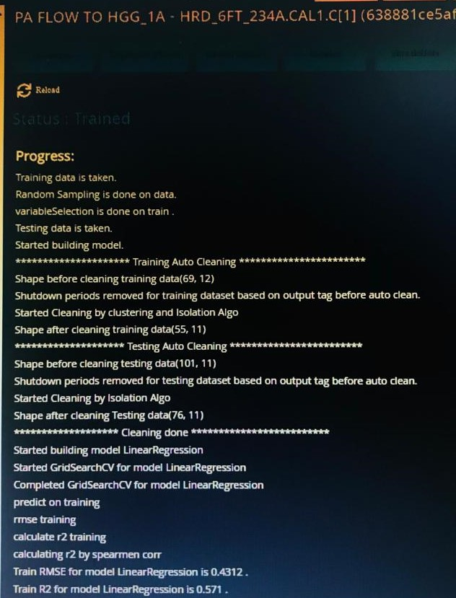
Training of the models by ExactSpace:

Slide 11
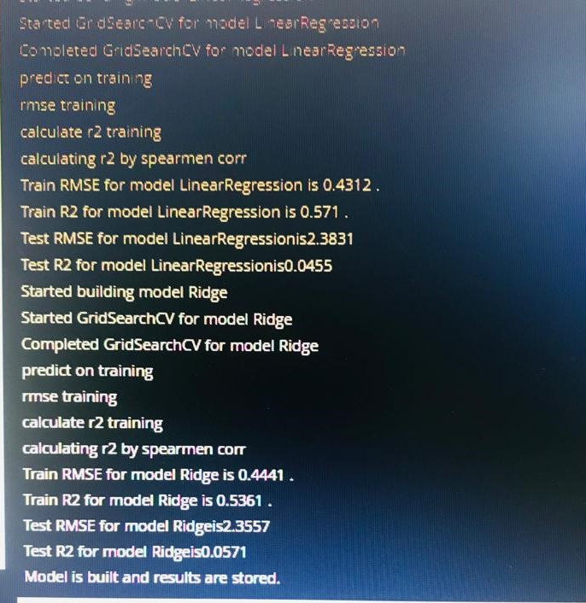
Clustering is used to group similar data points together, while the Isolation Forest algorithm is employed to identify and isolate anomalies or outliers in the data.
Isolation scores are assigned to data points, and those with high isolation scores are considered anomalies.
Spearman’s corr: It assesses the strength and direction of the monotonic relationship between two variables, even if that relationship is not linear.
What about missing value imputation, outlier handling , categorical value handling , principal component analysis techniques(pca),etc?

Slide 12
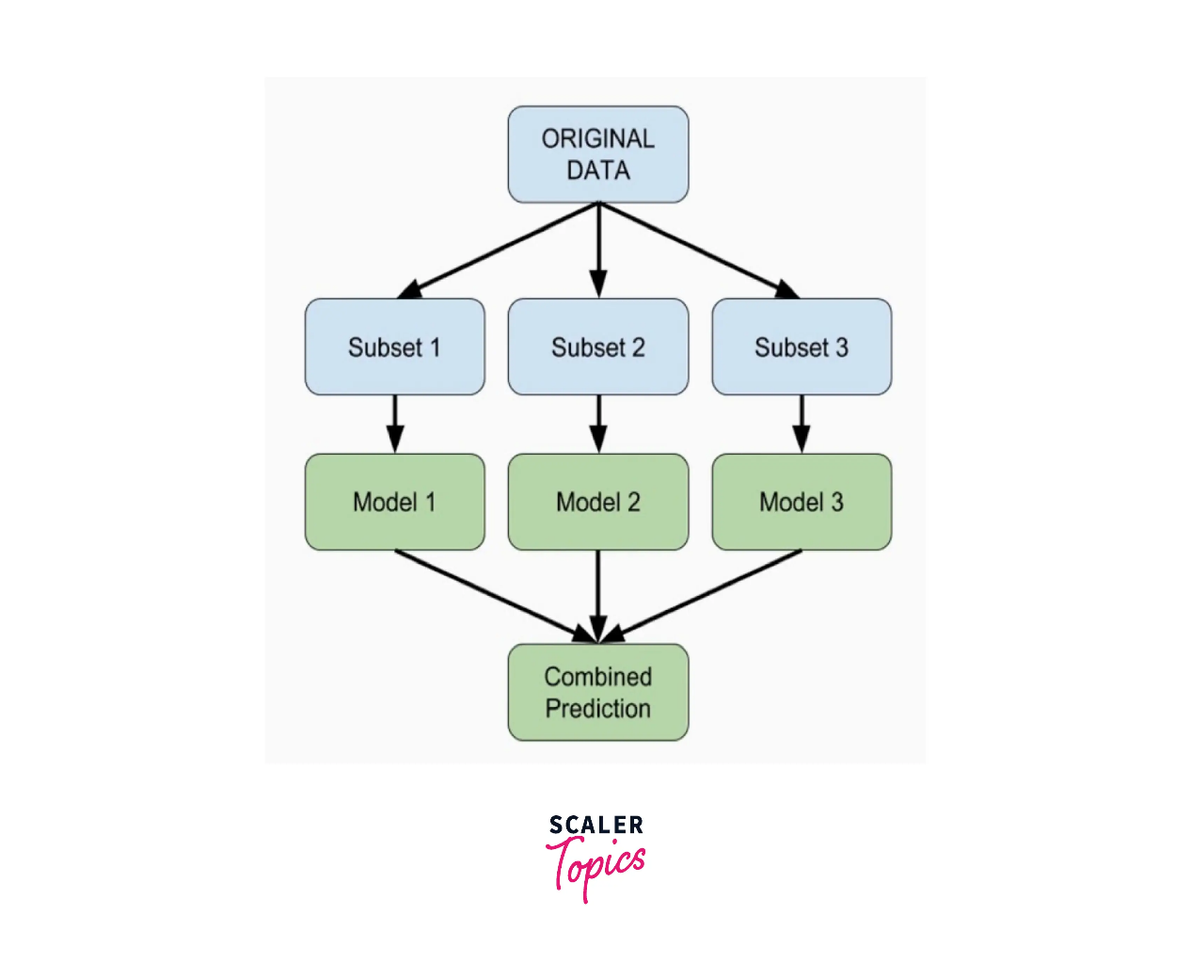
proposed Suggestions:
IMPROVE ACCURACY, REDUCE VARIANCE & INCREASE ROBUSTNESS BY ENSEMBLE METHOD: Ensemble learning is a machine learning technique that combines multiple models to create a more accurate and robust model. Ensemble models can often outperform single models, especially when the single models are diverse. This is because the ensemble model can learn from the strengths of each individual model and compensate for their weaknesses. Ensemble models can also help to reduce the variance of a model, which means that the model will be less likely to overfit the training data. This is because the ensemble model is averaging the predictions of multiple models, which helps to smooth out the noise in the data. Ensemble models can also be more robust to changes in the data than single models. This is because the ensemble model is not as sensitive to the errors of any individual model.

Slide 13
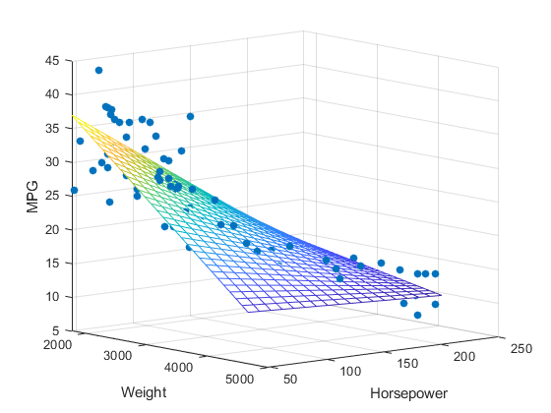
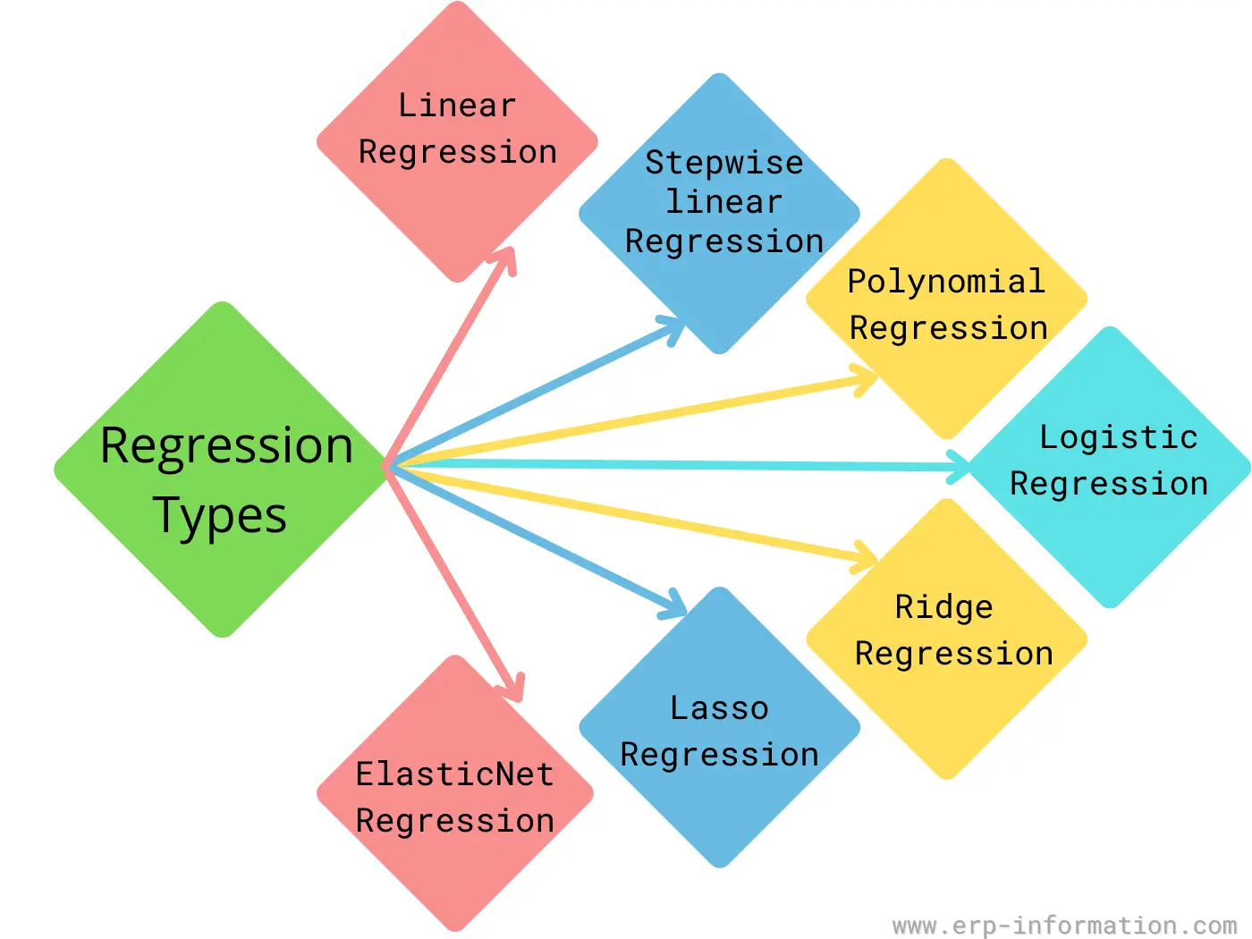
PERFORM BETTER REGRESSION ANALYSIS:
Use a few more regression models like xgboost, knn, decision tree, gaussian process, bayesian ridge, lightgbm, elasticnet etc that fits the domain/client requirement.
Multiple Linear Regression(3D)

Slide 14
MORE ROBUST CLEANING OF THE DATA:
Methods such as iterative imputation(handling missing values by multiple imputation as it’s considerate about the correlation between variables),
Winsorization(handling of outliers without dropping them in order to not lose a lot of data & to avoid compromising on quality of the prediction), The top 5% of the data is replaced by the value of the data at the 95th percentile and the value of the bottom 5% of the data is replaced by the value of the data at the 5th percentile.
Box-cox transformation(data transformation technique for relative normal distribution ),
PCA(dimensionality reduction),
OHE(for categorical features) etc or
Come up with better algorithms that does the data pre-processing in a way that fits the idea, demand & purpose of the client.

Slide 15
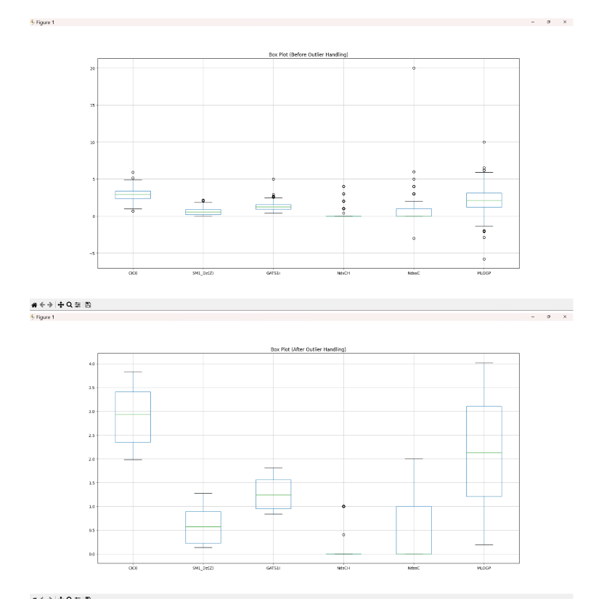

Slide 16
DOMAIN-EXPERTISE: It’s exceedingly important for smooth communication to be established between experts creating the models and experts using the models so that there’s regulated training and testing datasets according to the requirement and basis of the end result.
ESTABLISHMENT OF REGULATORY BODIES: To keep a check of smooth conduct from both ends for successful implementation of the models and eventually the entire digital twin project.
Utility
• Demand response
• Frequency regulation
• Volt control
Expected Future:
Internet was once a far-fetched dream, exactly how AI & ML feels today, and the future is quite evident.
AI & ML holds immense potential in manufacturing, and it is about leveraging data and automation to make processes more
Efficient,
Cost-effective, and
Sustainable.
As these technologies continue to advance, manufacturers that embrace AI and ML will be better positioned to thrive in an increasingly competitive global marketplace.

Slide 17
We are looking at :
A future with:
Predictive Maintenance
Quality Control and Defect Detection
Energy Efficiency
Human-AI Collaboration
Skills Development
Training and Upskilling will become critical in coming times.
What exactly is machine learning and predictive analysis?
"Turning Data into Destiny: Predictive Analysis and ML Miracles."

Slide 18



